Slide 1

Q&A SESSION ON DFF’S ARCTIC CALL FOR PROPOSALS 2025
Held in Torshavn as part of the workshop ‘Arctic Science in Action’. It was possible to participate online.
Tuesday 13 May 2025 at 4:30pm – 5:30pm (Faroese time zone)

Slide 2

Agenda
1
2
3
INTRODUCTION
WALKTHROUGH OF ARCTIC CALL
Q&A SESSION
Short introduction to DFF and the Q&A session
Presentation of the main elements of DFF’s call on Arctic research 2025
Time for specific questions to the call

Slide 3
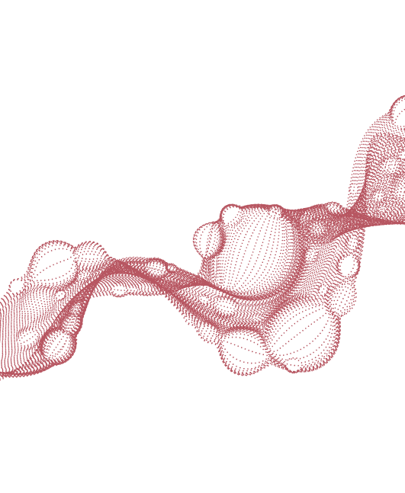
Independent Research Fund Denmark (DFF)
In 2025, DFF will grant DKK 2.1 billion for research projects, including DKK 46.5 million for the theme
of Arctic research
DFF creates space
to pursue original ideas
with as yet unknown
potential to improve
our lives and way of life.
Independent Research Fund Denmark (DFF) supports independent as well as thematic research based on:
Researchers’ own ideas
Within and across all main fields of science
To researchers at all career stages
DFF assessed 4,000 applications in 2024

Slide 4
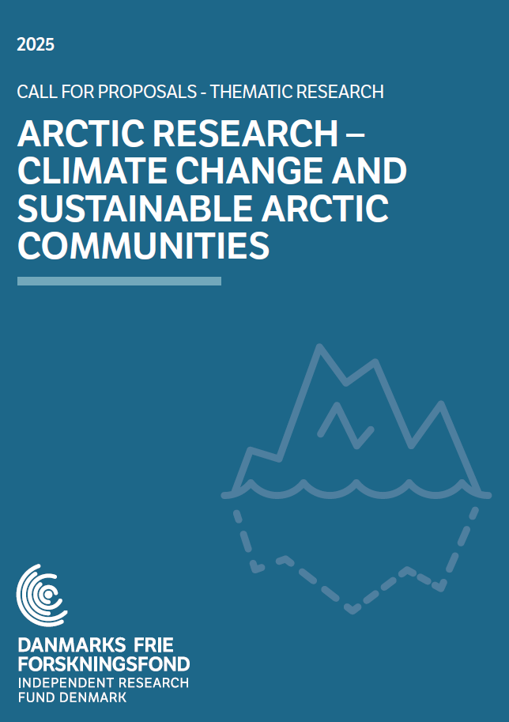
Call for Proposals
‘Arctic research’ is thematic research, which is politically determined by the Danish Government and Parliament.
The call has been formulated by the Board of DFF, and there has been dialogue with the research councils in Greenland and the Faroe Islands.

Slide 5
Call for Proposals
Application deadline:
Wednesday 3 September 2025 at 12:00
Available budget:
In total, DKK 46.5 million available
Applicants can apply for up to DKK 5 million excluding overhead
Response on committee’s decision:
November 2025

Slide 6
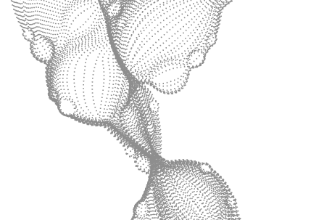
Call on Arctic research
Paragraph from call
Short summary
As a result of the Agreement on the research reserve, etc., 2025, DKK 46.5 million has been allocated to DFF with the purpose of strengthening Arctic research. According to the political agreement, the prioritisation can contribute to a sustainable development in the Arctic through a greater understanding of climate change and its impact on biodiversity, ecosystems, cultural heritage as well as living conditions in the Arctic, including a focus on involvement of the local population (including attention on Indigenous Peoples) and capacity building. The overall theme encompasses, among other things, knowledge about the challenges and solutions in regard to physicochemical conditions, climate feedback mechanisms, ecosystems and the living conditions of humans and animals. The effort can also contribute to increased knowledge about social and cultural changes and conditions in the Arctic communities as a result of, among other things, climate change, historical circumstances, etc.
First paragraph of the theme focus on:
Premise: This reflects the political agreement
Overall budget available (DKK 46.5 million; 6.2 million Euros)
Examples of research areas that fall within the theme (not an exhaustive list; other areas can apply as well)
Focus on involvement of the local population (including Indigenous Peoples)
Focus on capacity building

Slide 7
Call on Arctic research
Paragraph from call
Short summary
DFF emphasises that the text in the political agreement is broad, and that the call encompasses the possibility for research within and across all main research disciplines.
As a geographical starting point, DFF uses the definition of the Arctic from Arctic Monitoring & Assessment Programme (AMAP), which spans the member countries of the Arctic Council, in which the Danish Realm (Rigsfællesskabet) is represented. Please be aware of section 1.6 in the Arctic Call for Proposals regarding applicants/participants from Russian (and Belarussian) institutions, etc.
2nd and 3rd paragraphs of the theme focus on:
The theme is broad
Possible to apply within and across all research areas
DFF uses AMAP’s definition of the Arctic as a starting point (not the only possible definition)
Not possible to apply with applicants or parti-cipants employed at Russian or Belarusian institutions or for activities in these countries

Slide 8
Call on Arctic research
Paragraph from call
Short summary
DFF emphasises that all applications for this theme must include collaboration between researchers from at least two different research institutions. The research project’s applicant and Co-PI can, for example, be associated with different research institutions in Greenland, the Faroe Islands and/or Denmark. DFF encourages such collaborations, but DFF simultaneously emphasises that research projects without such forms of collaboration are not excluded from applying for this theme and obtaining a grant.
4th paragraph of the theme focus on:
Requirement: Collaboration between researchers from at least two different research institutions
Requirement: Co-PI must be included
DFF encourages projects where the applicant and Co-PI comes from different institutions in Greenland, the Faroe Islands and/or Denmark, but this is not required (and also not an assessment criterion)

Slide 9
Call on Arctic research
Paragraph from call
Short summary
To ensure research capacity building, DFF requires that all applications include at least one PhD student or postdoctoral candidate as specified in the theme-specific requirements below. PhD students and/or postdoctoral scholarships in the research project can, for instance, be fully or partially associated with research institutions in the Arctic.
At the same time, DFF requires that all applications involve general capacity building in the Arctic by means of involvement of the local population and/or Indigenous Peoples as an integrated part of the collaboration on the individual research project, as specified in the theme-specific requirements below.
5th and 6th paragraphs of the theme focus on:
Requirement: At least one PhD student or postdoctoral candidate in the project (research capacity building)
  Possible for PhDs and postdocs to be fully or partially associated with Arctic research institutions
Requirement: Applications must include involvement of the local population and/or Indigenous Peoples as an integrated part of the project (general capacity building)
  This can be done in different ways

Slide 10
Call on Arctic research
Paragraph from call
Short summary
Involvement and general capacity building can take place in different ways. The research project can, for instance, involve one or more of the local communities that the research is concerned with or has significance for, or one or more of the local communities close to which the research activities are carried out. The involvement can, among other things, be focused on how the research project involves the local population and Indigenous Peoples’ perspectives. A mutual transmission of knowledge can occur by means of the involvement, which will benefit the research project as well as the local community. The research project can be strengthened through the local community’s knowledge of the area, which is the subject of the research, and, at the same time, the knowledge and results of the research project can be shared with the local community. DFF urges that the involvement is initiated as early as possible, e.g. in the development stage of the project, and that the application contains relevant collaboration/support letters.
7th paragraph of the theme focus on:
One example of general capacity building:
  Involve the local communities that the research is concerned with; or where the research activities are carried out
  Mutual benefit: Project gains knowledge from local community and vice versa
  Involve local communities as early as possible, e.g. in the development stage
  Include relevant collaboration letters

Slide 11
Call on Arctic research
Paragraph from call
Short summary
Furthermore, involvement and general capacity building can also take place through the research project contributing to an increase in the general level of knowledge and competencies in the relevant local community or communities. DFF emphasises the importance of making the knowledge and results of the research project easily available, so that the produced knowledge can benefit and impact the Arctic in general and, specifically, the involved local communities.
In the appendix to your project description, you must account for how the research project includes general capacity building by means of involvement of the local population and/or Indigenous Peoples in the Arctic, including how it will be ensured that the involvement happens in an inclusive, credible, appropriate, respectful, and ethically acceptable manner. The account will be included in the fund’s overall assessment of your application.
8th and 9th paragraph of the theme focus on:
Another example of general capacity building:
  The project increases the general level of knowledge and competencies in the local community in question
Important to make knowledge and results from the project easily available, so that it can benefit and impact the Arctic and the involved local communities
Requirement: In the appendix, make sure to account for the involvement, and how it will be done in an acceptable manner

Slide 12
Call on Arctic research
Paragraph from call
Short summary
For further information and inspiration as well as links to examples of relevant guidelines and documents, DFF refers to an appendix on Indigenous Peoples’ perspectives in Arctic research, which appeared in NordForsk’s call Sustainable Development of the Arctic.
For research projects in Greenland, DFF also refers to Arctic Hub, which serves as a central point of contact for Greenland’s local and international research community. Arctic Hub can, among other things, assist with the creation of networks, arrange contacts and provide feedback on how to bridge between research and local communities.
For research projects in the Faroe Islands, DFF also refers to Granskingarráðið – Research Council Faroe Islands, which serves as a central point of contact for the Faroe Islands’ local and international research community. Granskingarráðið can, among other things, assist in arranging contact to institutions and researchers.
Three paragraphs of the theme focus on:
Working with Indigenous Peoples’ perspectives in Arctic research entails many different considerations – see the NordForsk appendix for inspiration
For projects in Greenland and the Faroe Islands, consider contacting relevant organisations that can be of assistance in various matters, e.g. arranging contacts between researchers and local communities

Slide 13
Call on Arctic research
Paragraph from call
Short summary
DFF notes that it is your responsibility, as an applicant, to ensure that your research project meets the national and international declarations, rules, guidelines, protocols, or similar, that are applicable in the particular area(s) where the research will take place, and/or where the research has concrete significance. The research project must also meet any research-ethical guidelines at an institutional level, etc. This applies, e.g., to research projects that fully or partially take place in, or has significance for Greenland or the Faroe Islands, where DFF refers to Greenland’s National Research Strategy from 2022 and Arctic Policy of the Faroe Islands from 2024. For research projects that involve Indigenous Peoples, DFF refers to the United Nations’ Declaration on the Rights of Indigenous Peoples as well as The Circumpolar Inuit Protocols for Equitable and Ethical Engagement, known as the EEE protocols.
The final paragraph of the theme focus on:
Across the Arctic region, there are many different rules, guidelines and protocols that apply for conducting research
Make sure to meet the (inter)national requirements for your research – it is your responsibility to ensure this
See also national strategies and policies from the country or area, where the research takes place, or has significance for

Slide 14

Project description and appendix
Project description: Max. 6 A4 pages and max. 18,000 characters
Account for the scientific project
  Objectives, scientific progress, state of the art, theory, method, empirical material, practical framework, management of risks, feasibility, dissemination, etc.
Appendix: Max. 2 A4 pages and max. 6,000 characters
Account for how the project addresses the Arctic theme and the theme-specific requirements and assessment criteria
  E.g. how the project involves general capacity building of research and in general, incl. involvement of local population and/or Indigenous Peoples in the Arctic
Account for the project’s expected, societal impact

Slide 15
Budget
You can apply for up to DKK 5 million excl. overhead
Researchers at institutions in the Faroe Islands and Greenland will receive same overhead as equivalent Danish institutions
You can apply for funding to cover all expenses that are directly attributable to the project, and which are relevant and necessary for the completion of the project, including for example:
Salaries, operating and equipment expenses
Costs related to participation of special rights holders and stakeholders
Interpreting assistance

Slide 16
Q&A SESSION
QUESTIONS?

Slide 17
THANK YOU
Please do not hesitate to contact us at
phone: +45 7231 8200 (weekdays 9am-12pm)
e-mail: DFF-Opslag@ufm.dk

